Slide 1
Code Exercise
Danesh Mishra

Slide 2
Problem Statement
Imagine an application that is deployed in 10 nodes. A node is a separate JVM process, potentially can be running on a different physical machine.
Write a simple application that will be running on ten nodes. The application needs to coordinate among the nodes and make sure that one
and only one of them do a System.out.println("We are started!"). The rest will printout("I have joined") as they start up.
Note: that not all ten nodes shall start at the same time. It is possible that some will start a couple of seconds/minutes later. Some will not start at all. Still, I want this message to be printed only once. You can use an existing library for the solution. No need to build a distributed system from scratch. Providing an elegant solution to the problem is what we seek.

Slide 3
Solution description
A simple java app Member. Java is created.
It will be instantiated through a launcher program called CreateMember.java
The launcher program will deploy Member App into 10 nodes (JVMs).
First node will print ‘We are started’ and all other members will print’I have joined’.

Slide 4
Solution description
In order to scale the Member App on 10 nodes we will use an open source IMDG product : Hazelcast (https://hazelcast.com/ ). It allows cross JVM communication, Messaging , application scaling, Cache-as-a-Service, In Memory processing & analysis etc.
We will also use Hazelcast’s Management center tool to verify and healthcheck all 10 nodes.
Note: free version of management center only allows to manage 2 nodes but we can still verify creation of all 10 nodes.

Slide 5
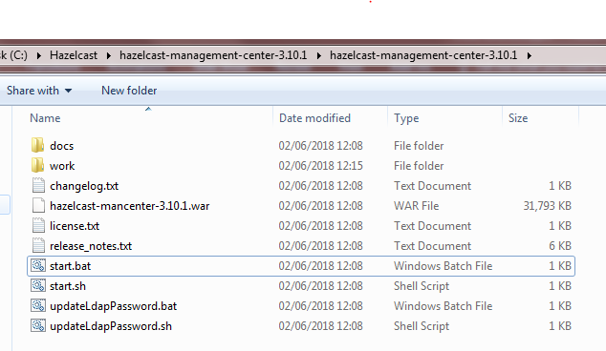
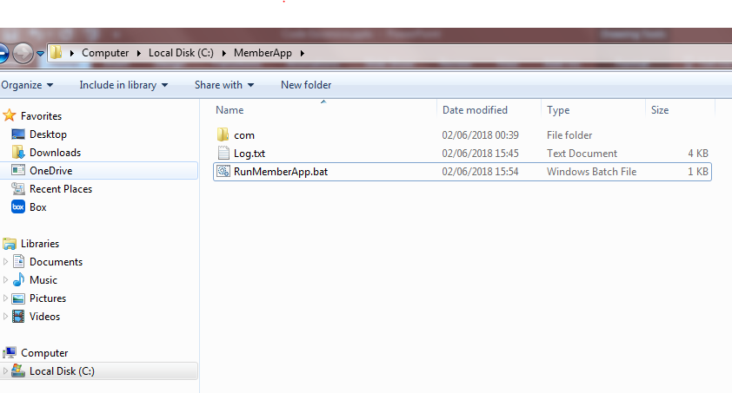
Running the MemberApp
Just change the HOME and JAVA path as per the target machine in RunMemberApp.bat and execute.
Member App will use Hazelcast to scale the app into multiple nodes.
Note: In order to run the MemberApp on Apple/Linux computer , just invoke- com.dm.sample.CreateMember.java.
Management center needs to be started separately from \hazelcast-management-center-3.10.1\Start.Bat

Slide 6
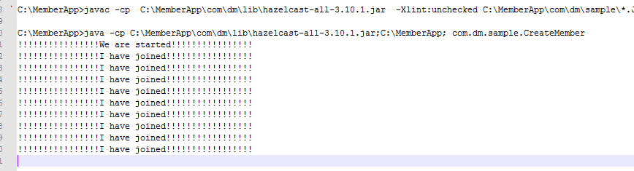
Results

Slide 7
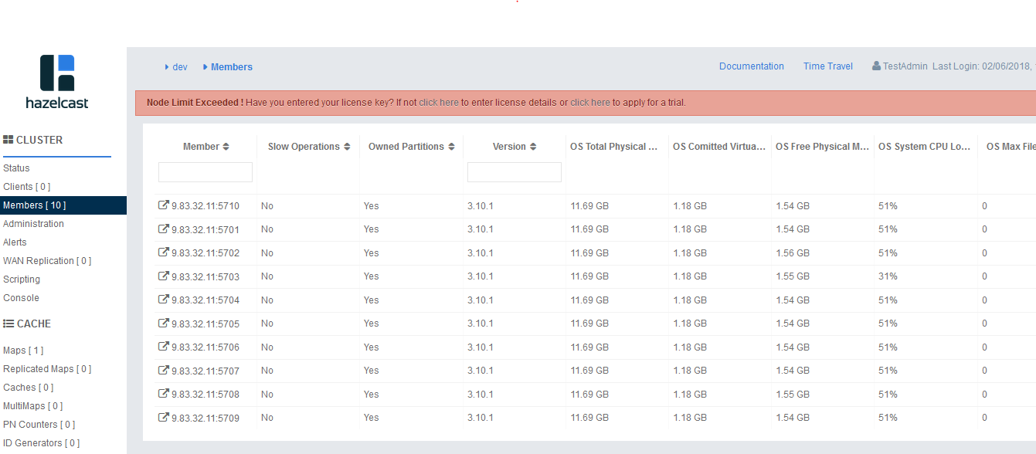
Hazelcast Management Center showing all 10 members.

Slide 8
Thanks

